Slide 1
ICIP Submission: Gaussian Decoder In VAE
Presenter: Kim Seung Hwan (overnap@khu.ac.kr)

Slide 2
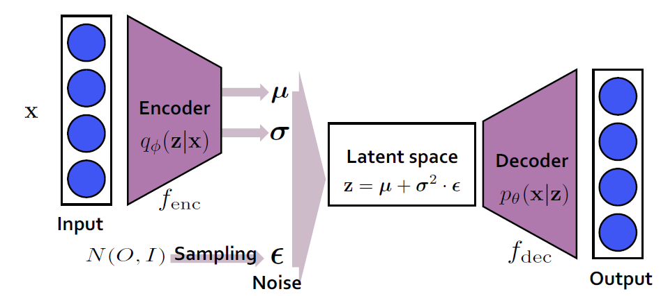
What is the VAE?
Variational Autoencoder (VAE)
Compression in generatable way
Data to latent, latent to (reconstructed) data

Slide 3
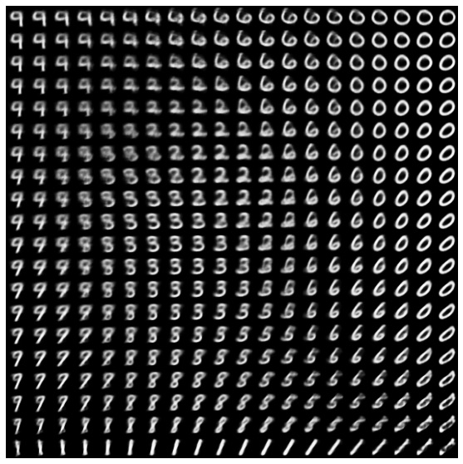
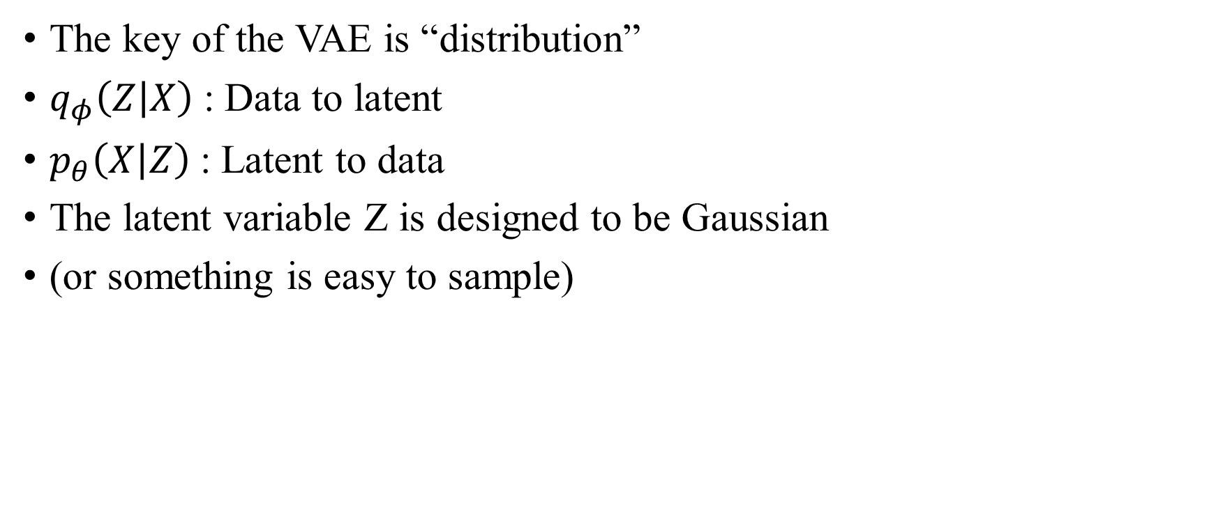
What is the VAE?
The key of the VAE is “distribution”
$q_{φ}\left(Z | X\right)$ : Data to latent
$p_{θ}\left(X | Z\right)$ : Latent to data
The latent variable Z is designed to be Gaussian
(or something is easy to sample)

Slide 4
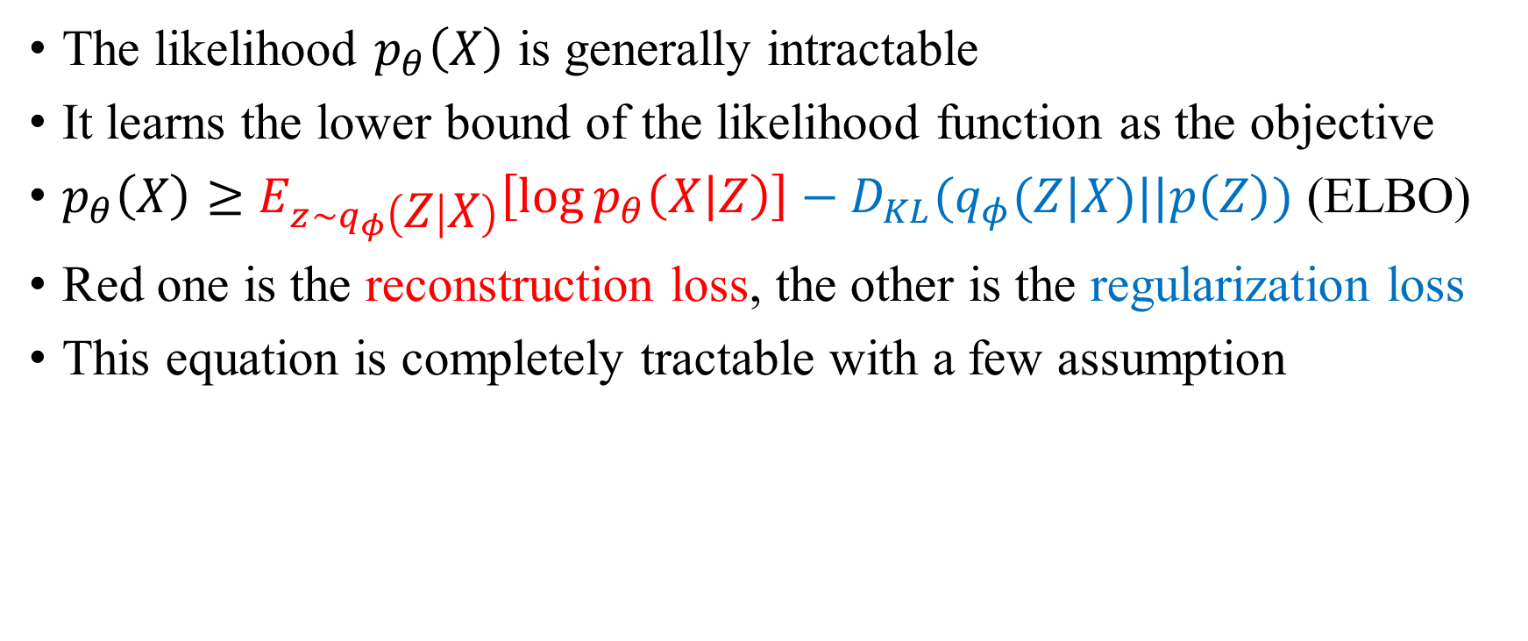
ELBO
The likelihood $p_{θ}\left(X\right)$ is generally intractable
It learns the lower bound of the likelihood function as the objective
$p_{θ}\left(X\right)≥E_{z\sim q_{φ}\left(Z | X\right)}\left[\log{p_{θ}\left(X | Z\right)}\right]−D_{KL}(q_{φ}(Z|X)||p\left(Z\right))$ (ELBO)
Red one is the reconstruction loss, the other is the regularization loss
This equation is completely tractable with a few assumption

Slide 5
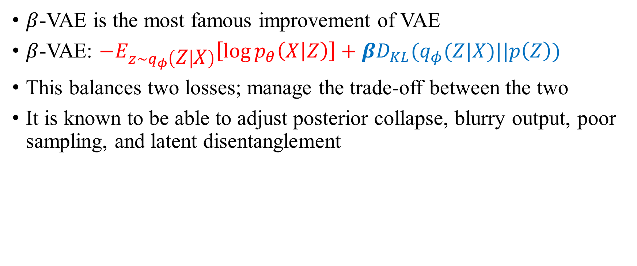
beta-VAE
$β$-VAE is the most famous improvement of VAE
$β$-VAE: $−E_{z\sim q_{φ}\left(Z | X\right)}\left[\log{p_{θ}\left(X | Z\right)}\right]+βD_{KL}(q_{φ}(Z|X)||p\left(Z\right))$
This balances two losses; manage the trade-off between the two
It is known to be able to adjust posterior collapse, blurry output, poor sampling, and latent disentanglement

Slide 6
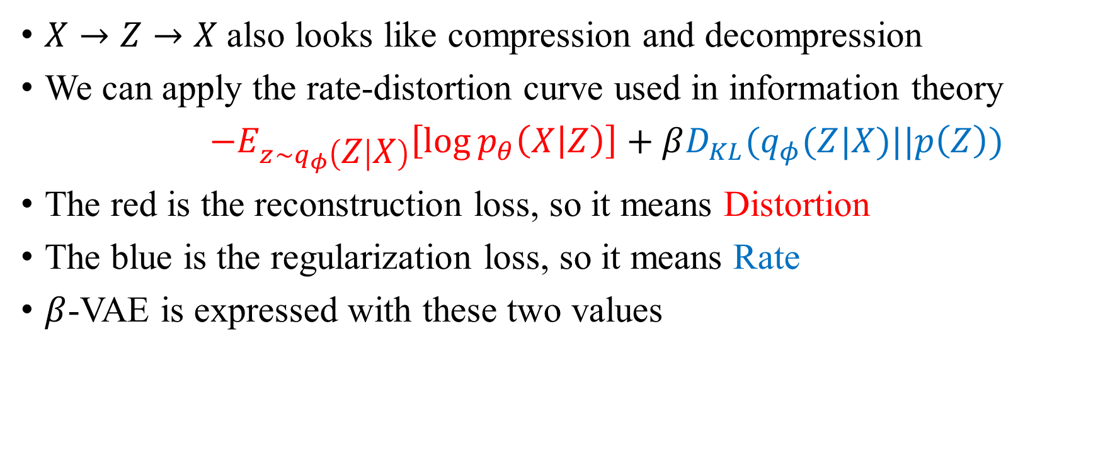
Rate-Distortion Curve
$X→Z→X$also looks like compression and decompression
We can apply the rate-distortion curve used in information theory
$−E_{z\sim q_{φ}\left(Z | X\right)}\left[\log{p_{θ}\left(X | Z\right)}\right]+βD_{KL}(q_{φ}(Z|X)||p\left(Z\right))$
The red is the reconstruction loss, so it means Distortion
The blue is the regularization loss, so it means Rate
$β$-VAE is expressed with these two values

Slide 7
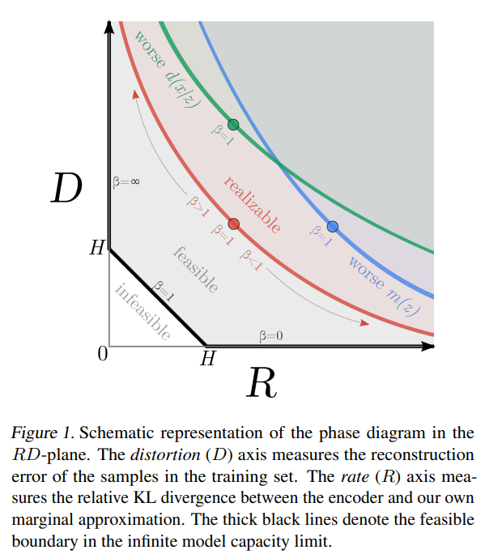


Rate-Distortion Curve
So the $β$-VAE is a point on the valid RD curve
And the $β$ is the parameter that causes it to move along it

Slide 8

Implementation of VAE
$p_{θ}\left(X | Z\right)$ and $q_{φ}\left(Z | X\right)$ are often modeled as Gaussian
$p_{θ}\left(X | Z\right)\sim N(μ_{X}\left(Z\right), σ_{X}\left(Z\right)I)$ – the shared diagonal covariance
$q_{φ}\left(Z | X\right)\sim N(μ_{Z}\left(X\right), σ_{Z}\left(X\right))$ – the diagonal covariance
Its diagonal covariance is known as an important assumption

Slide 9
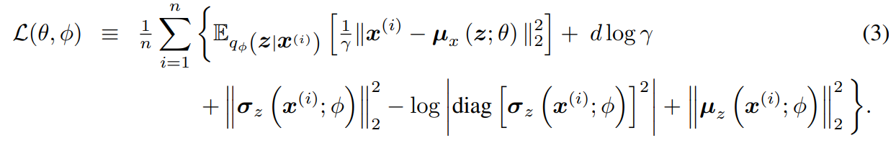

Implementation of VAE
$σ_{X}\left(Z\right)$ is usually set to be a constant
Trainable $σ_{X}\left(Z\right)$ introduces instability
$σ_{X}\left(Z\right)$ usually goes to 0 and this makes an infinite gradient
Greens can be infinitely large or small
Reconstruction loss (Distortion)
Regularization loss (Rate)

Slide 10
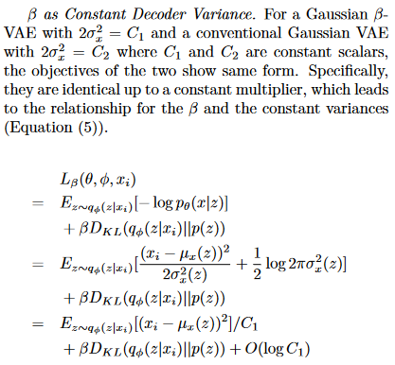
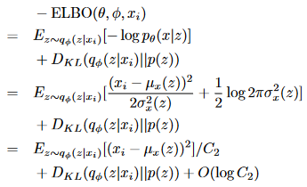

Connection between sigma and beta

Slide 11
Connection between sigma and beta
It is interesting connection indeed
But they are designed to get different effect
And this perspective hinders model analysis

Slide 12
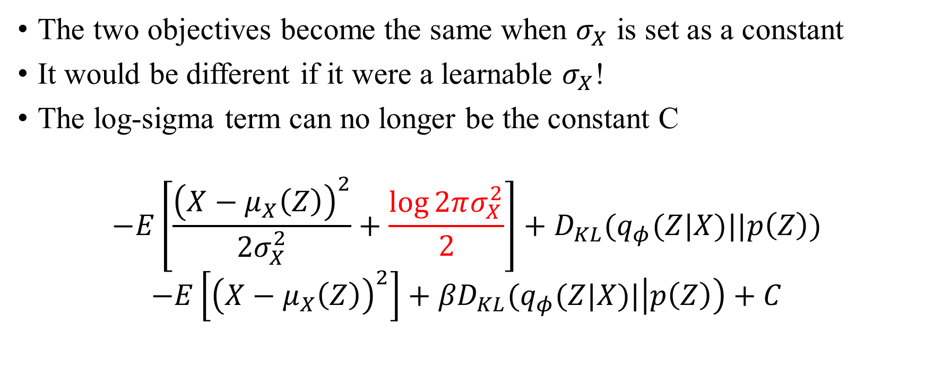
Learnable sigma
The two objectives become the same when $σ_{X}$ is set as a constant
It would be different if it were a learnable $σ_{X}$!
The log-sigma term can no longer be the constant C
$$−E\left[\frac{{\left(X−μ_{X}\left(Z\right)\right)}^{2}}{{2σ}_{X}^{2}}+\frac{\log{2πσ_{X}^{2}}}{2}\right]+D_{KL}(q_{φ}(Z|X)||p\left(Z\right))$$
$$−E\left[{\left(X−μ_{X}\left(Z\right)\right)}^{2}\right]+{βD}_{KL}(q_{φ}(Z|X)|\left|p\left(Z\right)\right)+C$$

Slide 13

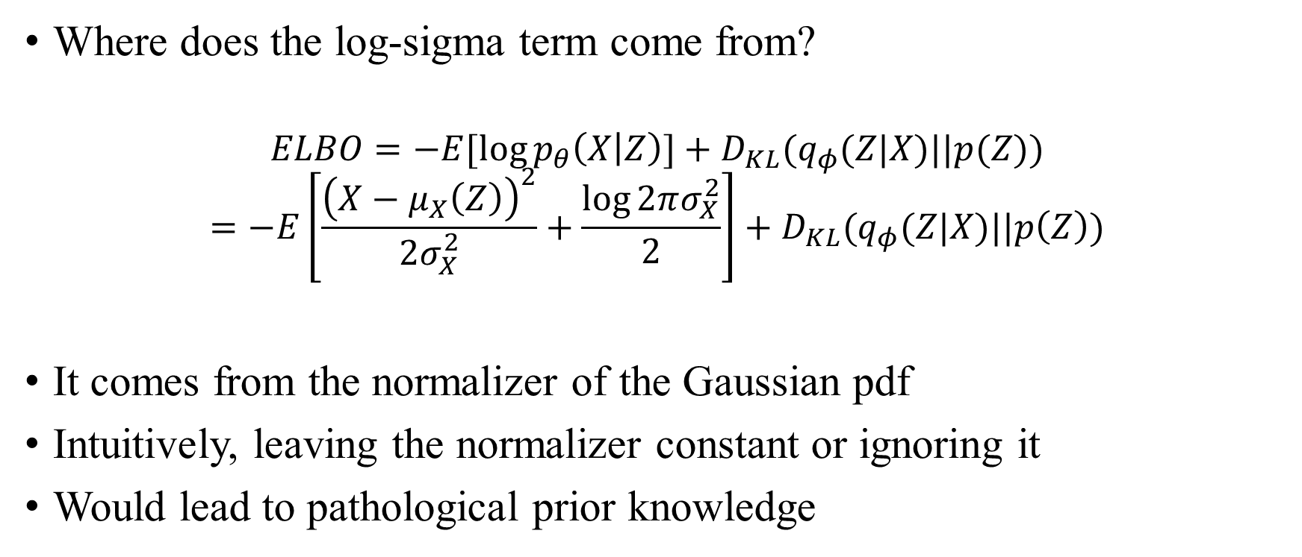
Learnable sigma
Where does the log-sigma term come from?
$$ELBO=−E[\log{p_{θ}\left(X | Z\right)}]+D_{KL}(q_{φ}(Z|X)||p(Z))$$
$$=−E\left[\frac{{\left(X−μ_{X}\left(Z\right)\right)}^{2}}{{2σ}_{X}^{2}}+\frac{\log{2πσ_{X}^{2}}}{2}\right]+D_{KL}(q_{φ}(Z|X)||p\left(Z\right))$$
It comes from the normalizer of the Gaussian pdf
Intuitively, leaving the normalizer constant or ignoring it
Would lead to pathological prior knowledge

Slide 14
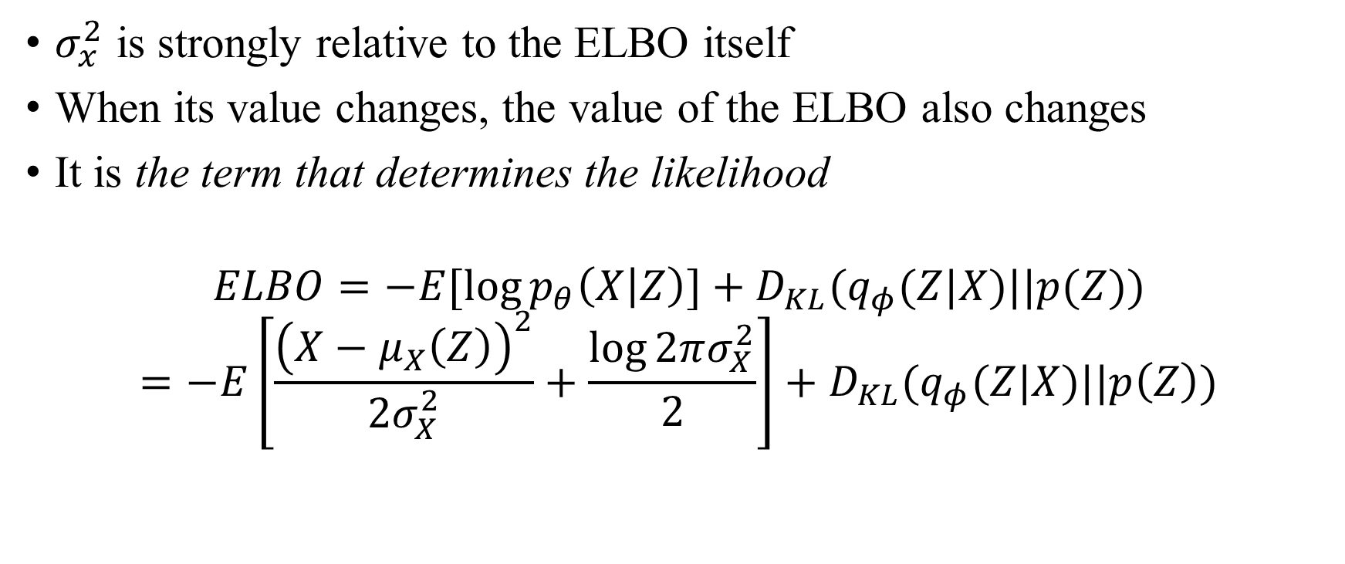
Problem 1: Design difference
$σ_{x}^{2}$ is strongly relative to the ELBO itself
When its value changes, the value of the ELBO also changes
It is the term that determines the likelihood
$$ELBO=−E[\log{p_{θ}\left(X | Z\right)}]+D_{KL}(q_{φ}(Z|X)||p(Z))$$
$$=−E\left[\frac{{\left(X−μ_{X}\left(Z\right)\right)}^{2}}{{2σ}_{X}^{2}}+\frac{\log{2πσ_{X}^{2}}}{2}\right]+D_{KL}(q_{φ}(Z|X)||p\left(Z\right))$$

Slide 15
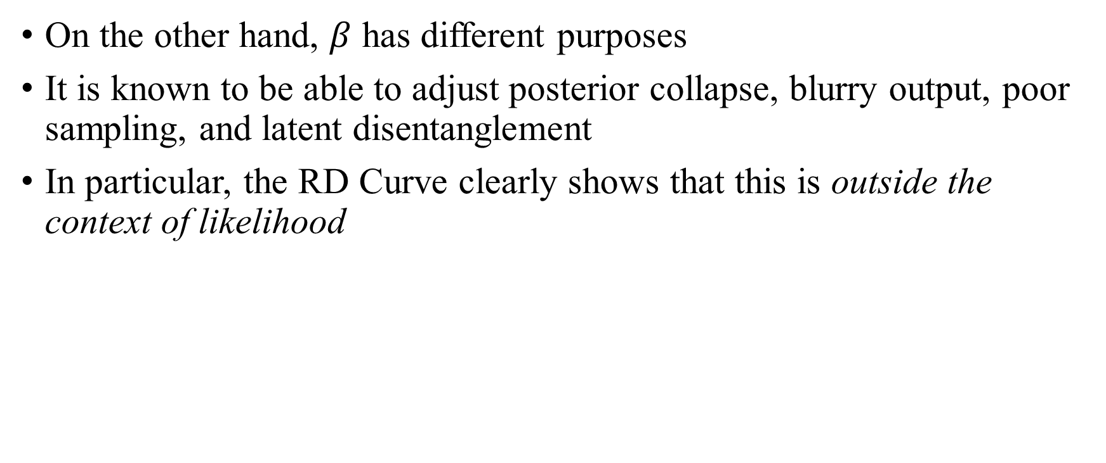
Problem 1: Design difference
On the other hand, $β$ has different purposes
It is known to be able to adjust posterior collapse, blurry output, poor sampling, and latent disentanglement
In particular, the RD Curve clearly shows that this is outside the context of likelihood

Slide 16
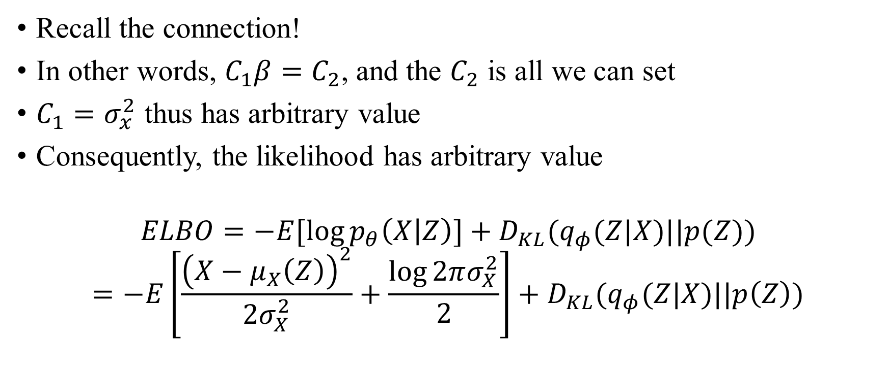
Problem 2: Non-deterministic likelihood
Recall the connection!
In other words, $C_{1}β=C_{2}$, and the $C_{2}$ is all we can set
$C_{1}=σ_{x}^{2}$ thus has arbitrary value
Consequently, the likelihood has arbitrary value
$$ELBO=−E[\log{p_{θ}\left(X | Z\right)}]+D_{KL}(q_{φ}(Z|X)||p(Z))$$
$$=−E\left[\frac{{\left(X−μ_{X}\left(Z\right)\right)}^{2}}{{2σ}_{X}^{2}}+\frac{\log{2πσ_{X}^{2}}}{2}\right]+D_{KL}(q_{φ}(Z|X)||p\left(Z\right))$$

Slide 17
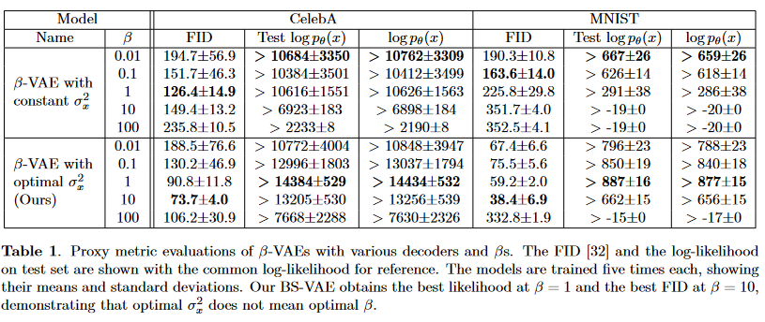

Problem 2: Non-deterministic likelihood
The likelihood value is the most important indicator to evaluate VAE
It can change arbitrarily depending on how the researcher considers $σ_{x}^{2}$

Slide 18

Separate them!
I argue that this is very bad!
The two parameters must be viewed separately
However, constant Gaussian VAE has in-separability by nature
I already explained the solution: make $σ_{x}^{2}$ learnable

Slide 19
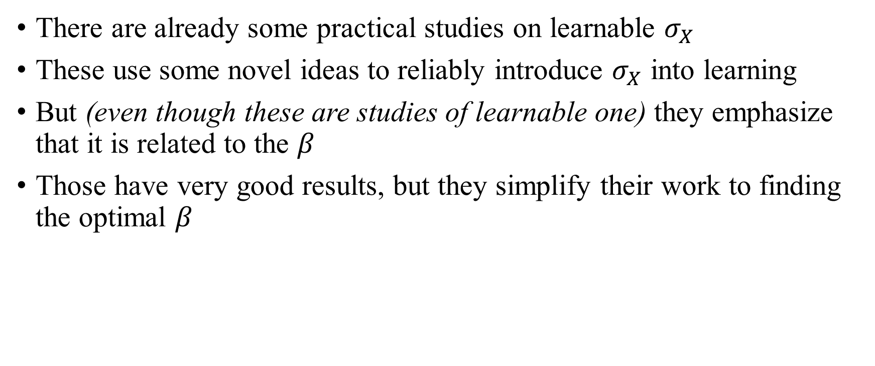
Implementation of Learnable sigma
There are already some practical studies on learnable $σ_{X}$
These use some novel ideas to reliably introduce $σ_{X}$ into learning
But (even though these are studies of learnable one) they emphasize that it is related to the $β$
Those have very good results, but they simplify their work to finding the optimal $β$

Slide 20
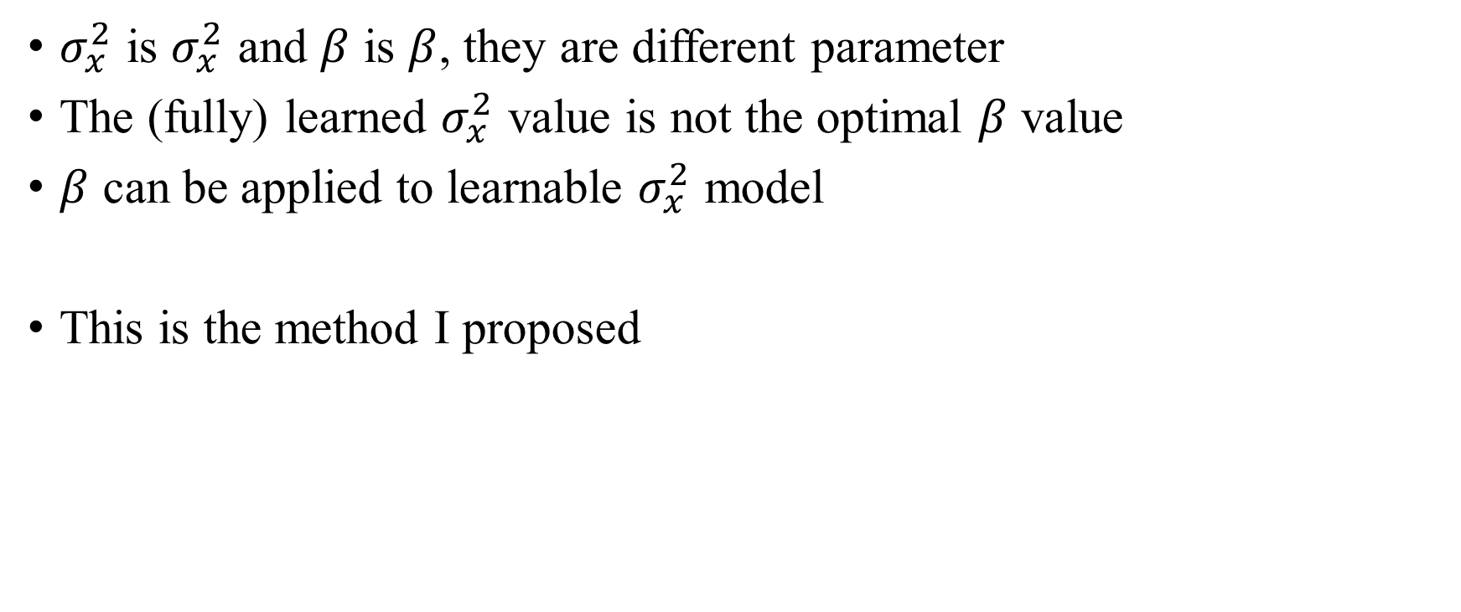
Method
$σ_{x}^{2}$ is $σ_{x}^{2}$ and $β$ is $β$, they are different parameter
The (fully) learned $σ_{x}^{2}$ value is not the optimal $β$ value
$β$ can be applied to learnable $σ_{x}^{2}$ model
This is the method I proposed

Slide 21
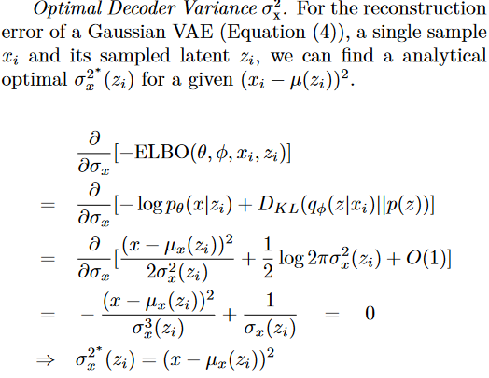
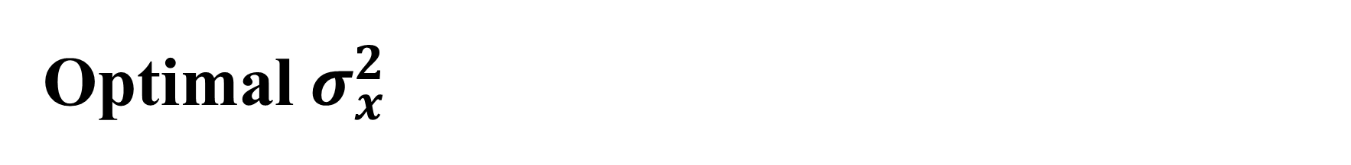
Optimal $σ_{x}^{2}$

Slide 22
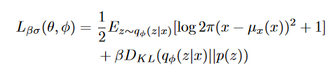

Loss
Ultimately, the proposed loss applied both Optimal $σ_{x}^{2}$ and $β$
It is very simple

Slide 23
Experiment

Slide 24
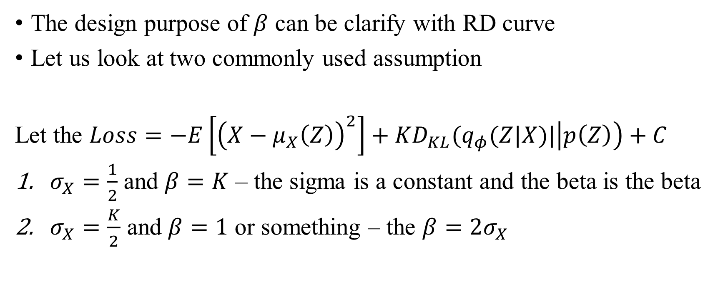
Experiment 1. Rate-Distortion Curve
The design purpose of $β$ can be clarify with RD curve
Let us look at two commonly used assumption
Let the $Loss=−E\left[{\left(X−μ_{X}\left(Z\right)\right)}^{2}\right]+{KD}_{KL}(q_{φ}(Z|X)|\left|p\left(Z\right)\right)+C$
$σ_{X}=\frac{1}{2}$ and $β=K$ – the sigma is a constant and the beta is the beta
$σ_{X}=\frac{K}{2}$ and $β=1$ or something – the $β=2σ_{X}$

Slide 25
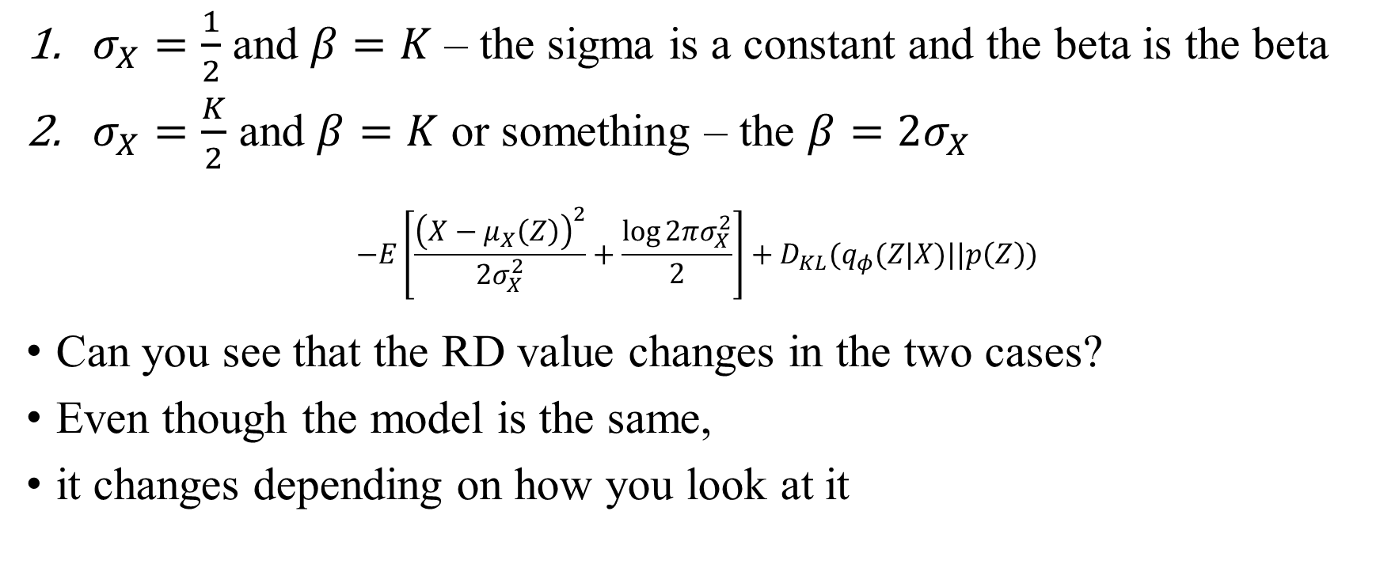
Experiment 1. Rate-Distortion Curve
$σ_{X}=\frac{1}{2}$ and $β=K$ – the sigma is a constant and the beta is the beta
$σ_{X}=\frac{K}{2}$ and $β=K$ or something – the $β=2σ_{X}$
$$−E\left[\frac{{\left(X−μ_{X}\left(Z\right)\right)}^{2}}{{2σ}_{X}^{2}}+\frac{\log{2πσ_{X}^{2}}}{2}\right]+D_{KL}(q_{φ}(Z|X)||p\left(Z\right))$$
Can you see that the RD value changes in the two cases?
Even though the model is the same,
it changes depending on how you look at it

Slide 26
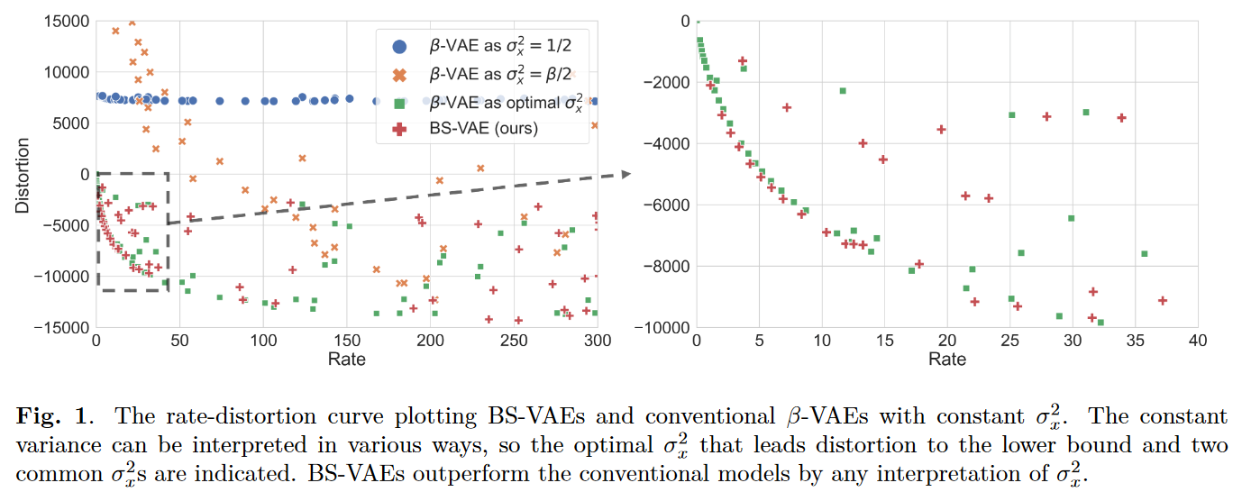
Experiment 1. Rate-Distortion Curve
Two common interpretation; they are very bad
Anyway, it is further down even in the optimal case
= Ours performs better

Slide 27
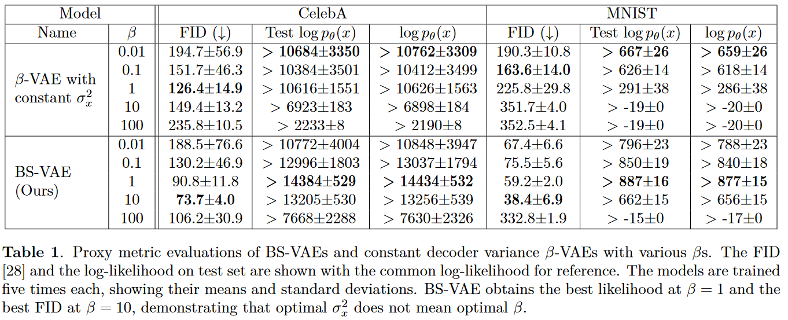
Experiment 2. Proxy Metric

Slide 28
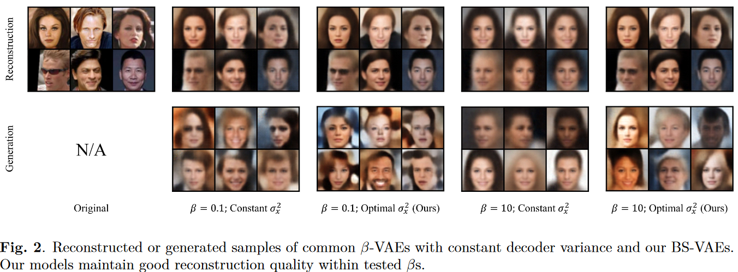
Experiment 3. Sample

Slide 29
Next Topic

Slide 30
Fast and efficient generative model
Quantization of latent variable – VQ-VAE
Binary representation is good for hierarchical information
Compatibility with the hyperbolic model?
...It is my imagination and intuition still

Slide 31
Fast and efficient generative model
In fact, VAE is fast model
The slowest generative model: Diffusion
Previously, I only read representative papers about it
I am going to read papers that make diffusion fast and efficient

Slide 32
Papers I missed
I am trying to read papers that I could not read because of the writing
Mainly two things:
Looking at VAE from a new perspective
e.g., “Variational Autoencoders: A Harmonic Perspective”
SSM and Mamba (The one surpassed Transformer in December 2023)
I have been reading these a lot recently
...I think it is enough to take two seminars

Slide 33
Thank you for listening
Presenter: Kim Seung Hwan (overnap@khu.ac.kr)

